Slide 1
TensorFlow Presentation Taylan Özgür Elma

Slide 2

TensorFlow (2015)
Open-source framework for numerical computations which combines machine learning models and algorithms

Slide 3
TensorFlow
Released in 2015
Developed by Google
Supported on multiple OSs
Huge library
Can work on multiple programing language
Very fast (CPU, GPU, TPU)

Slide 4
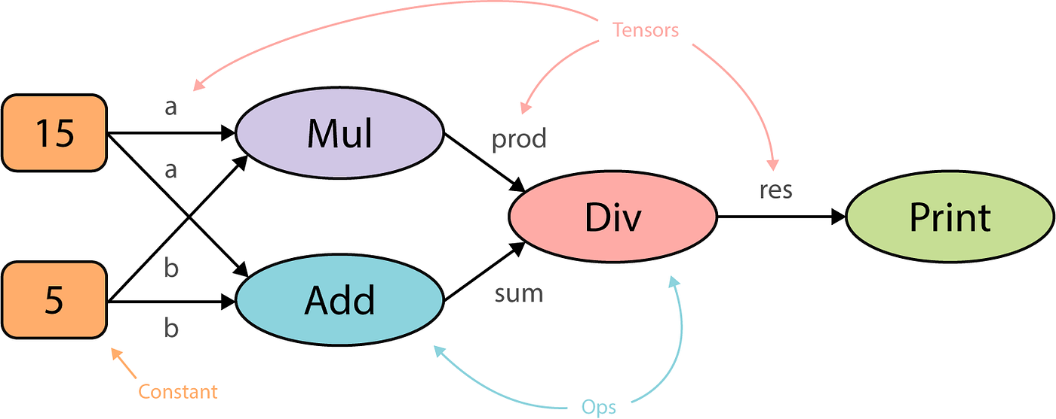
What is tensor?
Tensor is n dimentional array, a tensor's value all have same data type.
All operations on TensorFlow takes place on graphs.
Tensor consist edge and node. the node performs mathmatical actions.
Graphs represents computations
In Tensorflow, model is a graph containing Nodes.

Slide 5
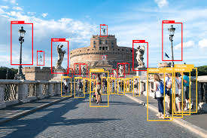
What can be done with TensorFlow?
Building and Training Machine Learning Models
Deploy Your Model Anywhere (iOS, Raspberry Pi)
Real-World Problem Solving (Medical images, complex datasets, scientific researches)

Slide 6
TensorFlow Interface and Backend
Generally Python is used for interface. In Tensorflow nodes and tensor are python objects and tensorflow applications are python applications.
C++ Backend: TensorFlow's core computational engine is written in C++, which is highly optimized for performance.
Optimized Execution: TensorFlow supports parallelism and hardware acceleration (TPU, GPU support)

Slide 7
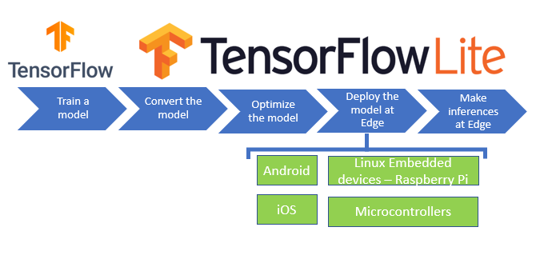
TensorFlowLite
Model Conversion: Converts TensorFlow models to TensorFlow Lite format using the TensorFlow Lite Converter.
Edge Computing: Process data at the source, reducing latency and enhancing responsiveness in edge computing environments.
IoT Devices: Enable smart functionalities in connected devices, like gesture recognition and predictive maintenance.
Model size accuracy trade-off.

Slide 8
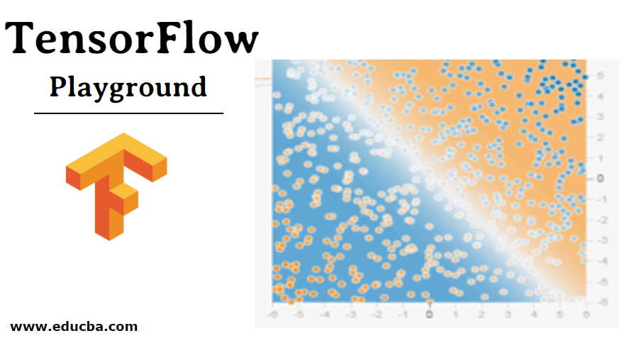
TensorFlow Playground
https://playground.tensorflow.org/

Slide 9

Google Colab

Slide 10
Thank you for listening

